Slide 1
Program 5 Discussion

Slide 2
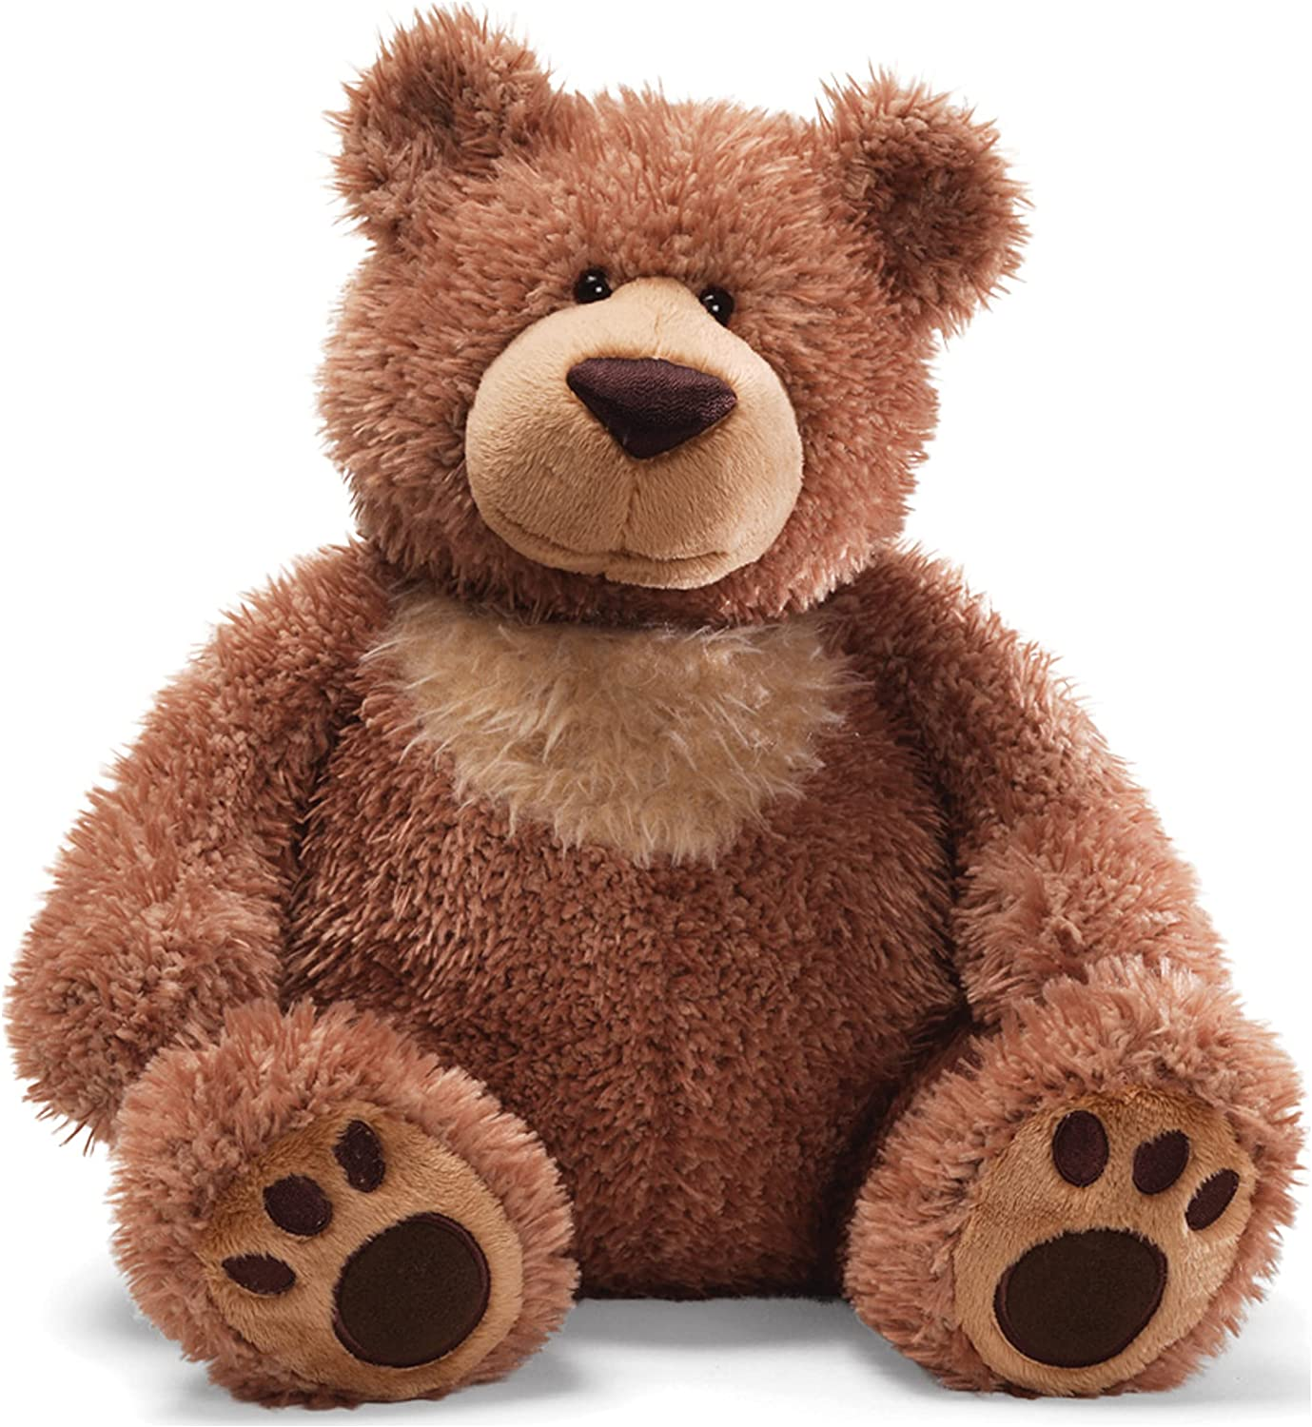
The idea of Vickrey was that we didn’t want the person to be competing with themselves.
So if I bid for a teddy bear, I should only pay what the system would have earned without me.

Slide 3

Vickrey Clarke Groves is trying to do the same thing with multiple bidders.
If I only want the “shades” teddy bear for $40, and Ian wants both for $60, and Jon wants the other teddy bear for $25
Who should get them? Me and Jon, right?
But what should we pay?
Me: $35 Without me ($60) with me Jon still pays 25
Jon: $20 Without me ($60) with Jon, I still pay 40

Slide 4

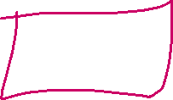

This problem is the same idea.
Slots for advertising (top slot is most valuable). 4 bidders Pay per click.
 | BIdder1 |  |  |  |  |  |  | No BIdder 1
 | Clicks expected | Bid per click | Expected Income |  |  |  |  | Clicks expected | Bid per click | Expected Income
Slot1 | 500 | 0.5 | 250 |  |  |  | Slot1 | 500 | 0.4 | 200
Slot2 | 300 | 0.4 | 120 |  |  |  | Slot2 | 300 | 0.3 | 90
Slot3 | 100 | 0.3 | 30 |  |  |  | Slot3 | 100 | 0.2 | 20
 | 0 | 0.2 | 0 |  |  |  |  | 0 | 0 | 0
 | What do others get with Bidder 1 |  | 150 |  |  |  |  |  |  | 310
 | Player 1 should pay |  | 0.32 | 160/500

Slide 5
This problem is the same idea.
Slots for advertising (top slot is most valuable). 4 biddes Pay per click.
 | BIdder2 |  |  |  |  |  |  | No BIdder 2
 | Clicks expected | Bid per click | Expected Income |  |  |  |  | Clicks expected | Bid per click | Expected Income
Slot1 | 500 | 0.5 | 250 |  |  |  | Slot1 | 500 | 0.5 | 250
Slot2 | 300 | 0.4 | 120 |  |  |  | Slot2 | 300 | 0.3 | 90
Slot3 | 100 | 0.3 | 30 |  |  |  | Slot3 | 100 | 0.2 | 20
 | 0 | 0.2 | 0 |  |  |  |  | 0 | 0 | 0
 | What do others get with Bidder 2 |  | 280 |  |  |  |  |  |  | 360
 | Bidder 2 should pay |  | .27 | =80/300

Slide 6
Examine the social welfare
Consider controlling the following parameters:
Number of bidders and the value per click for each bidder.
Closeness of bids (or pattern of bids). For example, (.5,.4,.3, .2, .1) or (.5, .45, .2, .1, .1)
Number of clicks expected for each slot (in decreasing order)
Number of advertising slots
Part 2
Suppose the bidders decide they don’t trust the mechanism and would rather pay a first price bid. The bidders can’t bid their true evaluation, as their social welfare would be zero (if they pay exactly what it is worth).They will need to bid strategically, knowing the number of bidders and the type of bidder distribution (without knowing specific bid values). No bidder will bid more than their valuation. Explain the bidding strategy used for each distribution. Show the actual valuation, the amount bid, and the social welfare of each case.

Slide 7
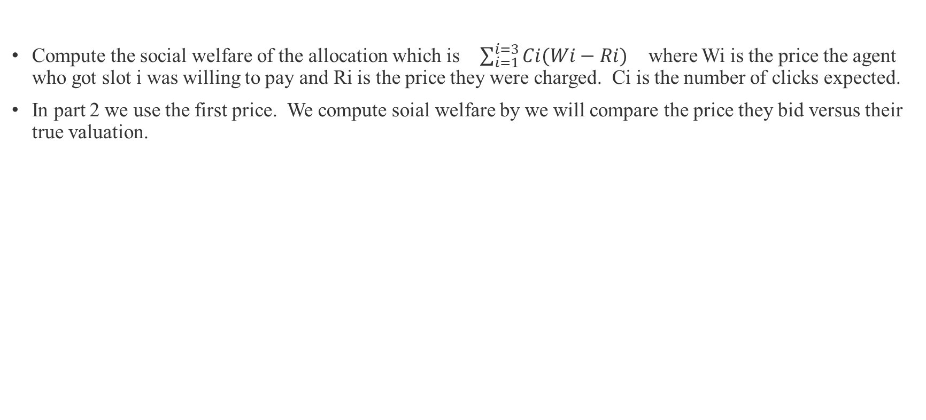
Social Welfare
Compute the social welfare of the allocation which is $\sum_{i=1}^{i=3}{Ci(Wi−Ri)}$ where Wi is the price the agent who got slot i was willing to pay and Ri is the price they were charged. Ci is the number of clicks expected.
In part 2 we use the first price. We compute soial welfare by we will compare the price they bid versus their true valuation.

